Slide 1
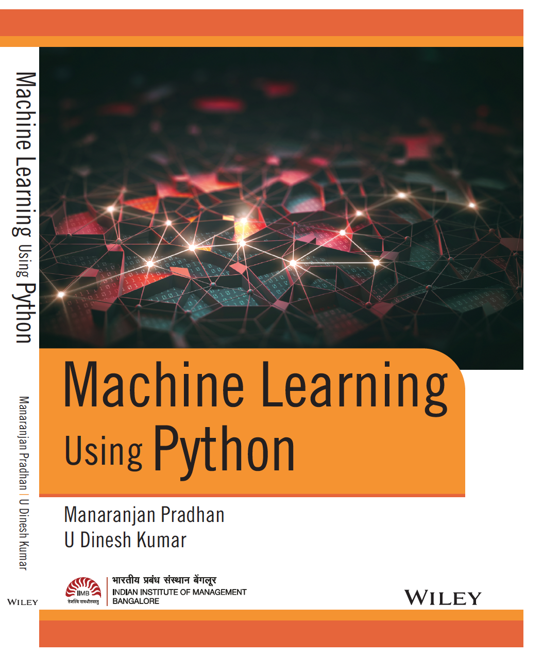
Chapter 02: Descriptive Analytics
Prepared By:

Slide 2
Learning Objectives
Working with DataFrames and perform basic exploratory Analysis
Data Preparation Activities: Filtering, grouping, ordering, joining etc.
Dealing with Missing Values
Prepare plots such as bar plot, histogram, distribution plot, box plot, scatter plot, pair plot and heat maps to find insights.

Slide 3
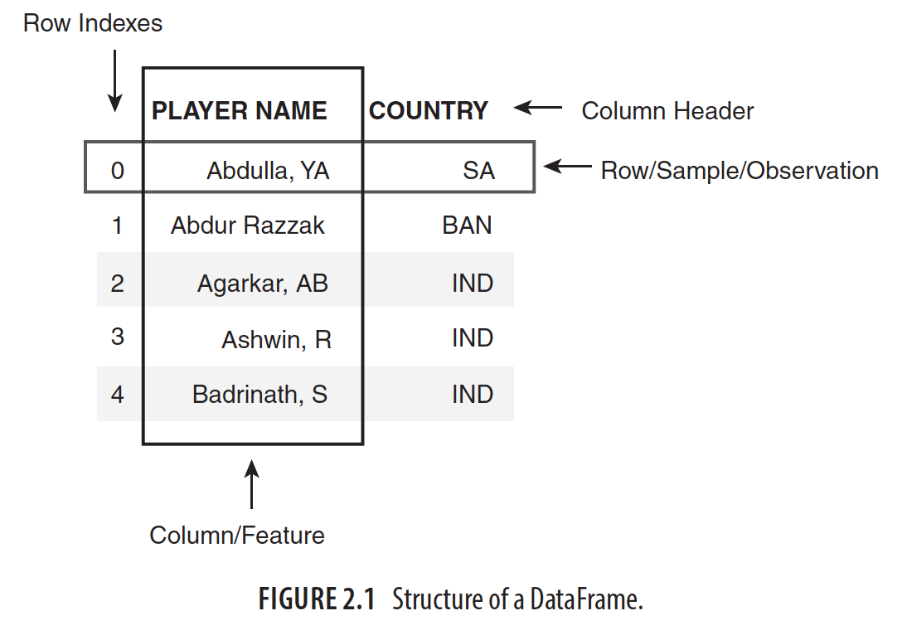
Working with DataFrame

Slide 4
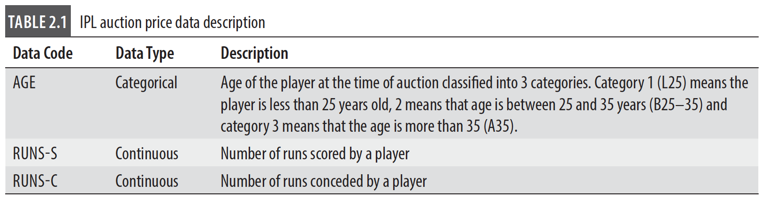
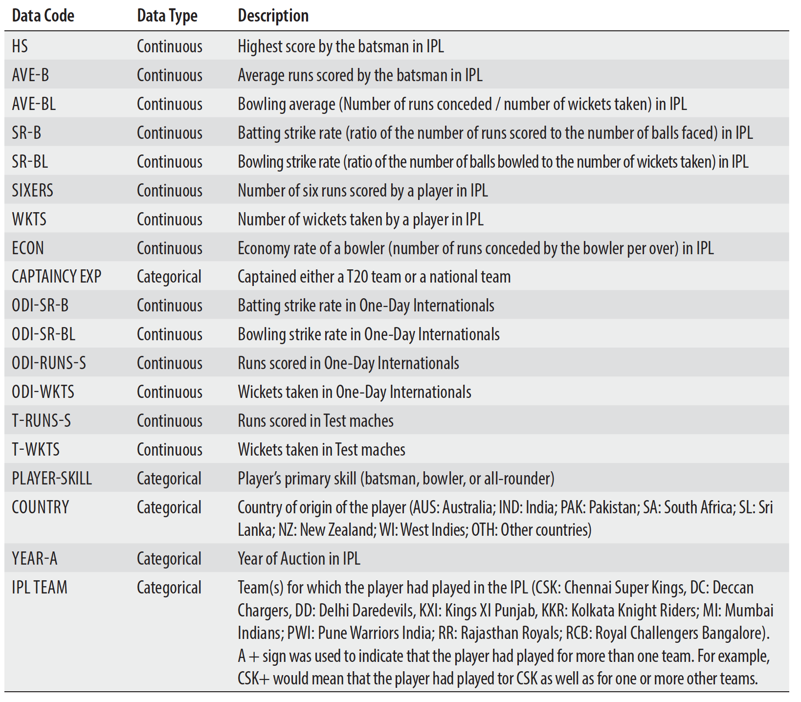
IPL Dataset

Slide 5

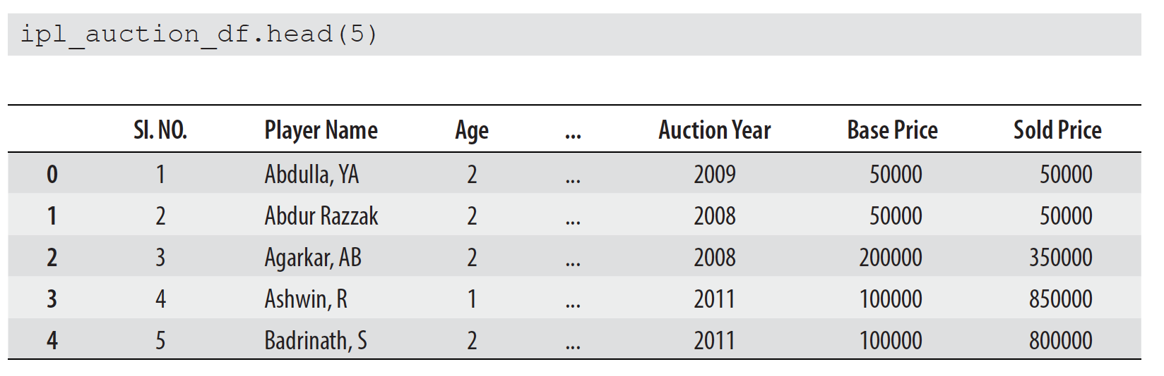
Loading Dataset into DataFrame

Slide 6
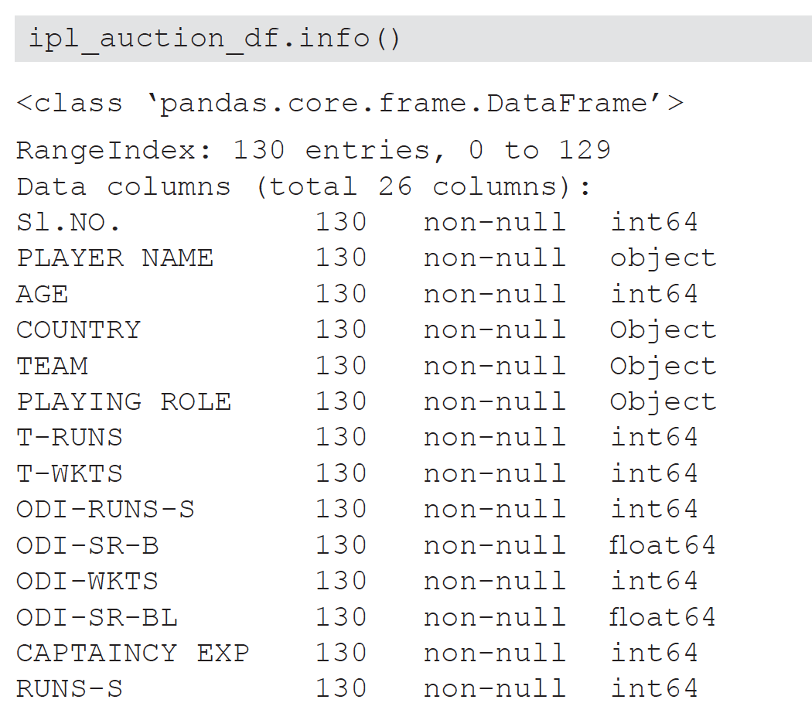
Finding Summary of the DataFrame

